Slide 1
AI-BASED FUEL EFFICIENT ROUTE OPTIMIZATION SYSTEM USING INTERNET OF VEHICLES (IOV)
Presented By:
Manali Ghosh (17600122054)
Ananya Pan (17600122045)
Dipankar Manna (17600122033)
Ankit Pramanick (17600122063)
Guided By: Rakhi Chakraborty Department of CSE Hooghly Engineering & Technology College

Slide 2
INTRODUCTION
Fuel consumption is a major concern due to rising fuel prices, traffic congestion, and pollution.
Traditional navigation apps show shortest or fastest routes.
They do not consider fuel usage, slope, driver behavior, or engine load.
Our project solves this by using AI, IoV data, Maps for fuel-optimized routing.

Slide 3
PROBLEM STATEMENT
Current navigation systems fail to consider driving behavior, elevation, engine load, and real fuel data, resulting in inaccurate route recommendations.
This leads to higher fuel consumption and unnecessary travel cost

Slide 4
CORE PROBLEM
Shortest route is not always the fuel-efficient route.
Factors like acceleration, slope, and traffic heavily affect fuel usage.
No existing system combines all real-world parameters into one prediction model.
This gap directly impacts cost, time, and sustainability.

Slide 5
PROPOSED SOLUTION
An AI-powered route optimization system that:
Predicts fuel consumption for each road segment using ML.
Uses eVED dataset for real driving & sensor behavior.
Adds elevation, slope & traffic data.
Generates multiple routes using OSM.
Recommends the most fuel-efficient route.

Slide 6
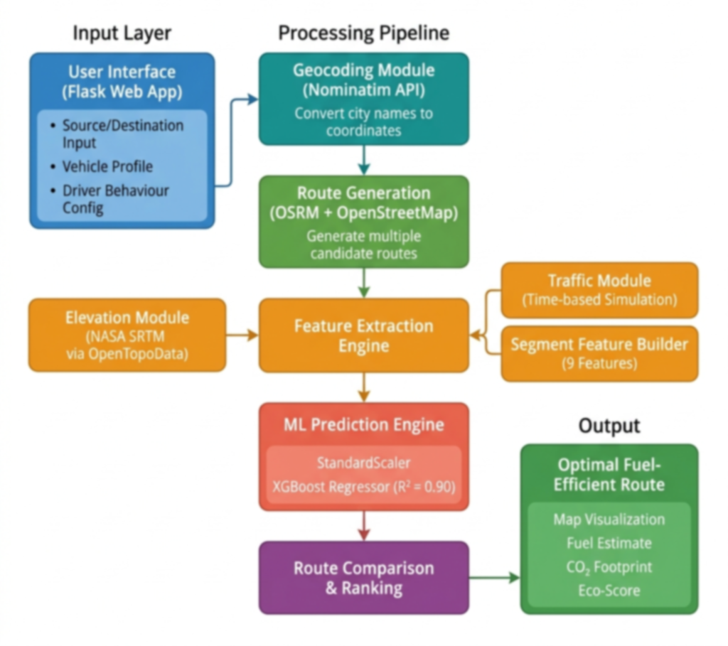
SYSTEM ARCHITECTURE

Slide 7
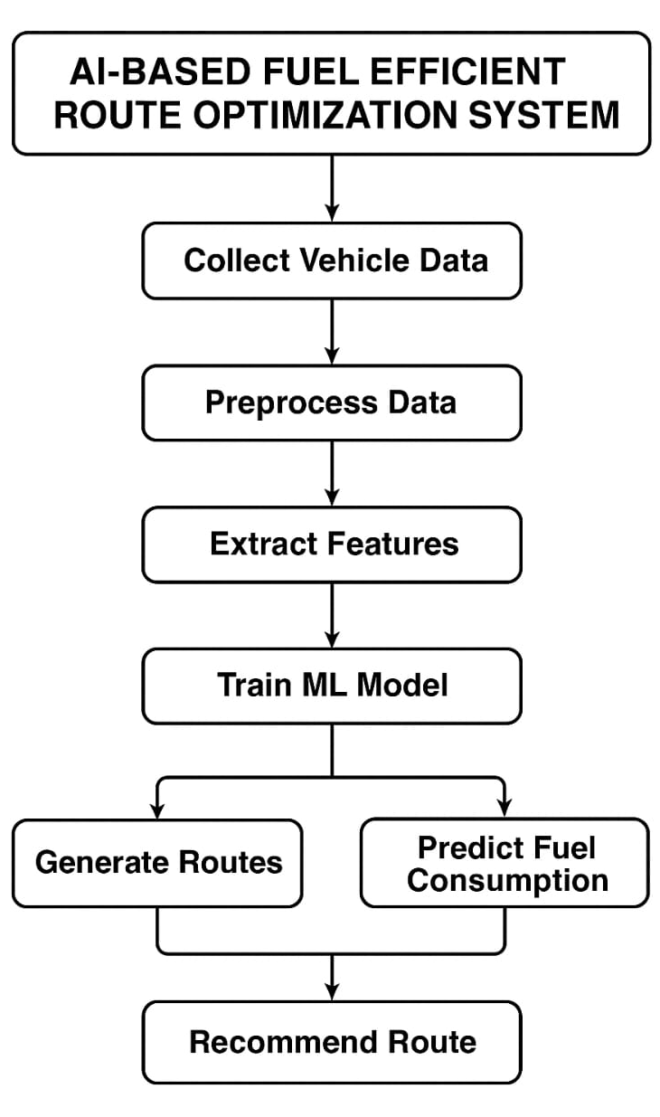
METHODOLOGY
The system follows a modular pipeline architecture:
1. USER INPUT → Flask-based web interface collects source, destination, and vehicle/driver profile (speed, acceleration, HP, temperature, load).
2. GEOCODING → Nominatim API converts location names to lat/lon coordinates.
3. ROUTE GENERATION → OSRM + OpenStreetMap generates multiple candidate routes with full GeoJSON geometry.
4. FEATURE EXTRACTION → For each route segment:
Elevation & slope from NASA SRTM (via OpenTopoData API)
Traffic congestion from time-based simulation module
9-feature vector built per segment
5. ML PREDICTION → XGBoost model (R² = 0.90) predicts fuel rate (L/hr) for each segment after StandardScaler normalization.
6. ROUTE COMPARISON → Segment fuel values are summed per route. The route with lowest total fuel is recommended.
7. OUTPUT → Map visualization with route overlays, fuel estimates,
CO₂ footprint, and Eco-Score displayed to user.

Slide 8
AI-BASED FUEL-EFFICIENT ROUTE OPTIMIZATION – ALGORITHM STEPS
Step 1: Generate all possible routes between the source and destination using OSM/OSRM.
Step 2: Use the trained ML model to predict fuel consumption for each segment of every route.
Step 3: Sum all the segment-level predictions to calculate the total fuel required for each route.
Step 4: Compare all routes and select the one with the lowest total fuel consumption.
This algorithm ensures that the selected route is not just shortest, but truly fuel-efficient based on behavior, terrain, and traffic factors.

Slide 9
DATASET DETAILS AND FEATURES
Dataset Overview
Name: eVED-Inspired Indian IoV Fuel Consumption Dataset
Type: Synthetic, physics-based (modeled after the Extended Vehicle Energy Dataset)
Size: 5,000 samples
Target Variable: Fuel Rate (Liters per hour)
Coverage: 10 Indian cities (Mumbai, Delhi, Bangalore, Kolkata, Chennai, Hyderabad, Pune, Jaipur, Lucknow, Ahmedabad)
Vehicle Classes: Hatchback, Sedan, SUV, MUV.
9 Features Used for ML Model
Feature | Description | Unit
Speed | Vehicle speed | km/h
Acceleration | Rate of speed change | m/s²
Slope | Road gradient (uphill/downhill) | degrees
Distance | Segment length | km
Congestion | Traffic congestion level | 0 / 1 / 2
Temperature | Ambient temperature (affects A/C load) | °C
StopGoFrequency | Number of stops per segment | count
Engine Load | Engine load percentage | %
Horsepower | Vehicle engine power | HP

Slide 10
TECHNOLOGIES USED (TECH STACK)
Programming
Python
Flask (web interface)
Machine Learning
Scikit-learn
XGBoost
Routing / Maps
OSRM
OSMnx
OpenStreetMap
Data Sources
eVED Dataset
NASA SRTM Elevation
Google Maps / TomTom Traffic API

Slide 11
BENEFITS
Saves fuel cost
Reduces CO₂ emissions
Considers real driving behavior
Better than traditional shortest-path apps
Suitable for navigation apps & logistics
Supports sustainable transportation

Slide 12
CHALLENGES
Cleaning the large eVED dataset
Mapping GPS points with elevation data
Integrating multiple APIs together
Ensuring ML model accuracy
Real-time traffic handling

Slide 13
LIMITATIONS
Dependent on availability of API data
Not real-time without constant updates
Accuracy depends on dataset quality
Heavy computation for long routes
Traffic data may sometimes be inaccurate

Slide 14
FUTURE SCOPE
EV Battery-Aware Route Optimization: Extend the system for electric vehicles by considering current battery status, distance, traffic, and available charging station locations to optimize energy-efficient travel.
Real-Time Sensor Integration (OBD-II): Connect with live vehicle data through OBD-II interface to access real-time speed, engine performance, and fuel usage — allowing dynamic route adjustment based on actual vehicle conditions.
Pothole-Aware Routing: Use vehicle sensor and smartphone data to detect road surface irregularities like potholes and recommend smoother alternative routes, improving ride comfort and reducing vehicle wear.
Reinforcement Learning for Adaptive Eco-Routing: Apply RL techniques that continuously learn from traffic patterns, road conditions, and driver behaviour over time — dynamically improving route suggestions for maximum fuel efficiency.
Integration with Public Transport Systems: Combine personal vehicle routing with bus, metro, and train schedules to suggest hybrid multimodal travel options, reducing traffic congestion and promoting sustainable urban mobility.

Slide 15
CONCLUSION
The system uses AI to improve route planning.
Considers real-world factors ignored by traditional apps.
Helps save fuel, reduce emissions, and optimize travel.
Useful for navigation apps, logistics, and smart cities.

Slide 16
REFERENCES
B. Aslam, F. Khan, "Eco-Routing: Energy-Efficient Routing for Vehicles using Road and Traffic Information," IEEE Transactions on Intelligent Transportation Systems, 2019.
S. S. A. Shah et al., "Machine Learning-Based Fuel Consumption Prediction Using Vehicle Telematics Data," Applied Energy, vol. 260, 2020.
K. Boriboonsomsin and M. Barth, "Eco-Driving: Modeling and Control for Fuel Efficiency," IEEE ITS, 2014.
M. Barth and K. Boriboonsomsin, "Energy and Emissions Impact of Freeway Speed Limits and Lane Management Strategies," Transportation Research Record, 2008.
J. Kwon et al., "Impact of Road Grade on Vehicle Fuel Consumption," Journal of Transportation Engineering, 2013.
L. Sun et al., "Predicting Vehicle Energy Consumption Using Machine Learning Incorporating Road Grade and Driver Behaviour," Energy, 2021.

Slide 17
THANK YOU

